Slide 1





Bayesian Graphical Modeling
Network Comparisons
PsyNets Winterschool 2026
m.marsman@uva.nl
bayesiangraphicalmodeling.com

Slide 2
Setup Today
Estimating & Testing
Group Comparison
Clustering
Morning Session
Afternoon Session

Slide 3
Setup Today
Estimating & Testing
Group Comparison
Clustering
Morning Session
Afternoon Session

Slide 4
Setup Today
Estimating & Testing
Group Comparison
Clustering
Morning Session
Afternoon Session

Slide 5




Session setup
Part I: Theory
Part II: Tutorial / Practical
image: Flaticon.com

Slide 6
Session setup
Part I: Theory
image: Flaticon.com

Slide 7

A Network of ADHD Variables
Nodes are ADHD symptoms (present/absent).
Edges are partial associations.
Goal is to determine conditional dependence relationships.
Silk, et al. (2019). A network analysis approach to ADHD symptoms: More than the sum of its parts. PLOS ONE, 14(1), e0211053.

Slide 8
A Network of ADHD Variables
Nodes are ADHD symptoms (present/absent).
Edges are partial associations.
Goal is to determine conditional dependence relationships.
Silk, et al. (2019). A network analysis approach to ADHD symptoms: More than the sum of its parts. PLOS ONE, 14(1), e0211053.

Slide 9
A Network of ADHD Variables
Nodes are ADHD symptoms (present/absent).
Edges are partial associations.
Goal is to determine conditional dependence relationships.
Silk, et al. (2019). A network analysis approach to ADHD symptoms: More than the sum of its parts. PLOS ONE, 14(1), e0211053.

Slide 10
A Network of ADHD Variables
Nodes are ADHD symptoms (present/absent).
Edges are partial associations.
Goal is to determine conditional dependence relationships.
Silk, et al. (2019). A network analysis approach to ADHD symptoms: More than the sum of its parts. PLOS ONE, 14(1), e0211053.

Slide 11
Ising Model or Ordinal Markov Random Field
Marsman, M., van den Bergh, D., & Haslbeck, J. (in press). Bayesian Analysis of the Ordinal Markov Random Field. Psychometrika.

Slide 12
Ising Model or Ordinal Markov Random Field
Nodes are binary or ordinal variables.
Marsman, M., van den Bergh, D., & Haslbeck, J. (in press). Bayesian Analysis of the Ordinal Markov Random Field. Psychometrika.

Slide 13
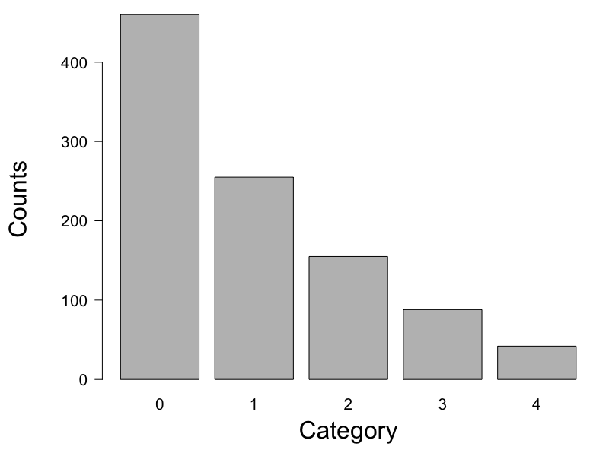
Ising Model or Ordinal Markov Random Field
Marsman, M., van den Bergh, D., & Haslbeck, J. (in press). Bayesian Analysis of the Ordinal Markov Random Field. Psychometrika.

Slide 14
Ising Model or Ordinal Markov Random Field
Marsman, M., van den Bergh, D., & Haslbeck, J. (in press). Bayesian Analysis of the Ordinal Markov Random Field. Psychometrika.

Slide 15
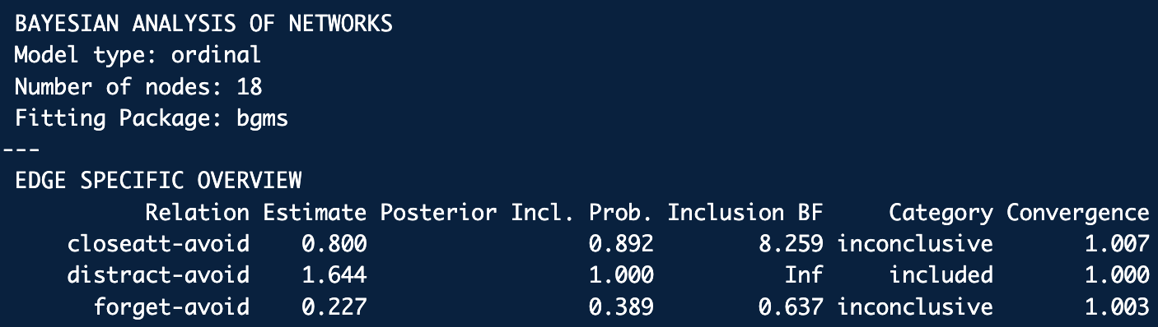
Ising Model or Ordinal Markov Random Field
Marsman, M., van den Bergh, D., & Haslbeck, J. (in press). Bayesian Analysis of the Ordinal Markov Random Field. Psychometrika.

Slide 16
Ising Model or Ordinal Markov Random Field
Conditional independence?
Marsman, M., van den Bergh, D., & Haslbeck, J. (in press). Bayesian Analysis of the Ordinal Markov Random Field. Psychometrika.

Slide 17
Ising Model or Ordinal Markov Random Field
Conditional independence?
Marsman, M., van den Bergh, D., & Haslbeck, J. (in press). Bayesian Analysis of the Ordinal Markov Random Field. Psychometrika.

Slide 18
Networks for Diagnosed and Undiagnosed
Diagnosed (n = 146)
Undiagnosed (n = 209)
Silk, et al. (2019). A network analysis approach to ADHD symptoms: More than the sum of its parts. PLOS ONE, 14(1), e0211053.

Slide 19
Networks for Diagnosed and Undiagnosed
How could we assess sample differences?
Diagnosed (n = 146)
Undiagnosed (n = 209)
Silk, et al. (2019). A network analysis approach to ADHD symptoms: More than the sum of its parts. PLOS ONE, 14(1), e0211053.

Slide 20
Networks for Diagnosed and Undiagnosed
How could we assess sample differences?
Diagnosed (n = 146)
Undiagnosed (n = 209)
Silk, et al. (2019). A network analysis approach to ADHD symptoms: More than the sum of its parts. PLOS ONE, 14(1), e0211053.

Slide 21
Networks for Diagnosed and Undiagnosed
How could we assess sample differences?
Silk, et al. (2019). A network analysis approach to ADHD symptoms: More than the sum of its parts. PLOS ONE, 14(1), e0211053.

Slide 22
Model the Difference in Edge Weight
Diagnosed (n = 146)
Undiagnosed (n = 209)
Silk, et al. (2019). A network analysis approach to ADHD symptoms: More than the sum of its parts. PLOS ONE, 14(1), e0211053.
Marsman, Waldorp, Sekulovski, & Haslbeck (2025). Bayes factor tests for group differences in ordinal and binary graphical models. Psychometrika, 90.

Slide 23
Model the Difference in Edge Weight
Diagnosed (n = 146)
Undiagnosed (n = 209)
Marsman, Waldorp, Sekulovski, & Haslbeck (2025). Bayes factor tests for group differences in ordinal and binary graphical models. Psychometrika, 90.

Slide 24
Test the Difference in Edge Weight
Rather than testing whether an edge weight should be included or excluded (i.e., conditional independence), we now test if an edge difference should be included or excluded (i.e., edge invariance).
Marsman, Waldorp, Sekulovski, & Haslbeck (2025). Bayes factor tests for group differences in ordinal and binary graphical models. Psychometrika, 90.

Slide 25
Test the Difference in Edge Weight
Rather than testing whether an edge weight should be included or excluded (i.e., conditional independence), we now test if an edge difference should be included or excluded (i.e., edge invariance).
Marsman, Waldorp, Sekulovski, & Haslbeck (2025). Bayes factor tests for group differences in ordinal and binary graphical models. Psychometrika, 90.

Slide 26
Test the Difference in Edge Weight
Rather than testing whether an edge weight should be included or excluded (i.e., conditional independence), we now test if an edge difference should be included or excluded (i.e., edge invariance).
Marsman, Waldorp, Sekulovski, & Haslbeck (2025). Bayes factor tests for group differences in ordinal and binary graphical models. Psychometrika, 90.

Slide 27
Test the Difference in Edge Weight
Diagnosed (n = 146)
Undiagnosed (n = 209)
Marsman, Waldorp, Sekulovski, & Haslbeck (2025). Bayes factor tests for group differences in ordinal and binary graphical models. Psychometrika, 90.

Slide 28
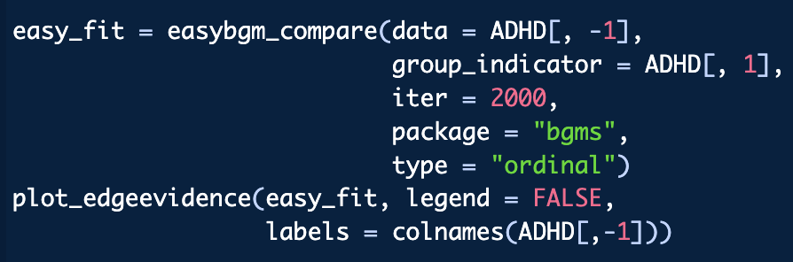
Test the Difference in Edge Weight
Diagnosed (n = 146)
Undiagnosed (n = 209)
Marsman, Waldorp, Sekulovski, & Haslbeck (2025). Bayes factor tests for group differences in ordinal and binary graphical models. Psychometrika, 90.

Slide 29
Why Compare Groups?
Assess Network Variance or Invariance
Do network structures (response behavior) differ between groups?
Which relations are stable (invariant) across groups?
Where do key differences emerge?
This illustrates the psychometric perspective, and relates to questions about differential item functioning or measurement invariance in IRT/SEM frameworks.
Marsman, Waldorp, Sekulovski, & Haslbeck (2025). Bayes factor tests for group differences in ordinal and binary graphical models. Psychometrika, 90.

Slide 30
Why Compare Groups?
Assess Network Variance or Invariance
Reproducibility
Do network results reproduce in different samples?
Do network results generalize to different populations?
A central motivation for developing Bayesian approaches to group comparisons is the concern about reproducibility in network psychometrics.
Marsman, Waldorp, Sekulovski, & Haslbeck (2025). Bayes factor tests for group differences in ordinal and binary graphical models. Psychometrika, 90.

Slide 31
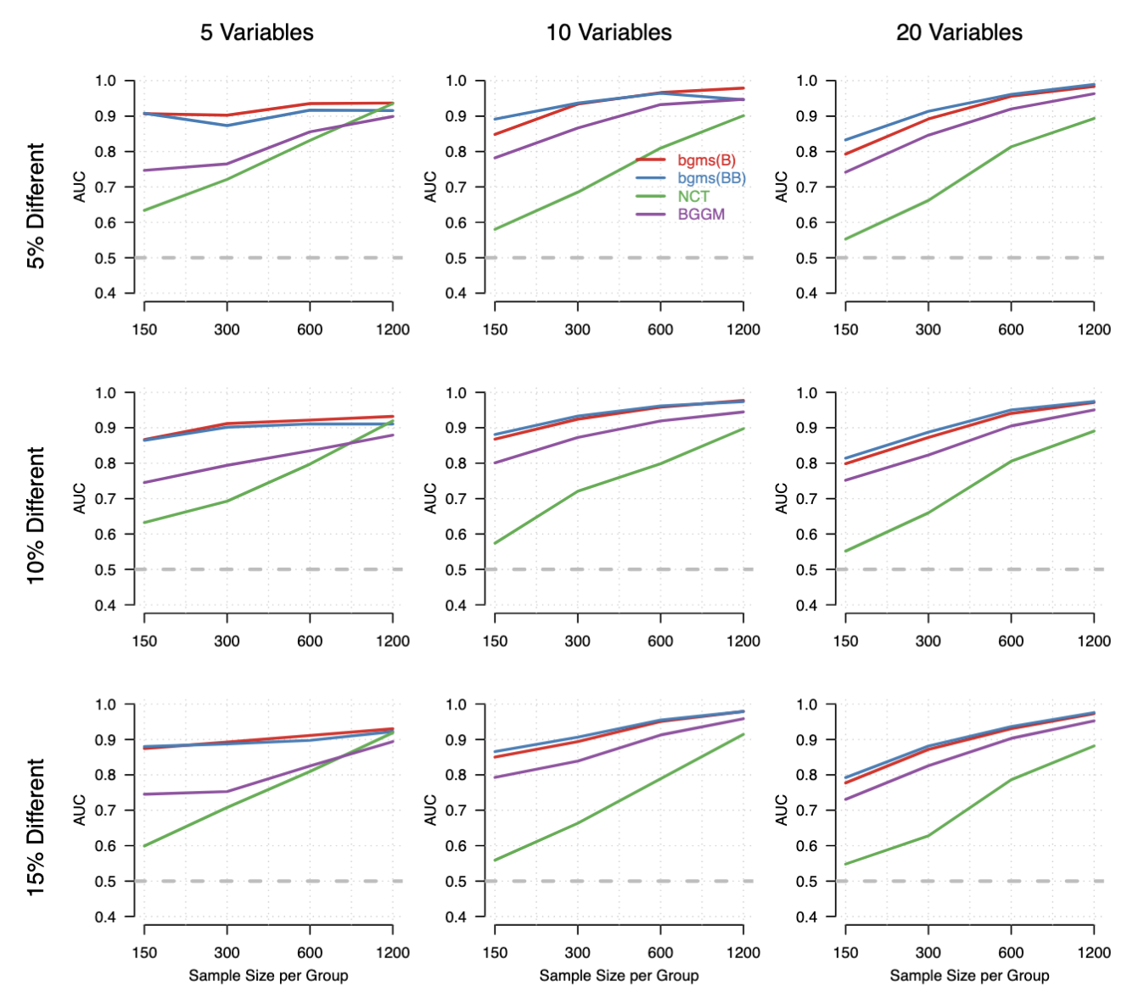
Simulation Evidence
Area under the ROC curve
Threshold-free summary of detection accuracy
0.5 = chance; higher = better
Design:
Variables: 5, 10, 20
Edge differences: 5–15%
Sample size: 150–1200 per group
Results:
Bayesian MRF methods perform best overall
Strong gains in small samples and low signal
NCT competitive with large samples & few variables
Marsman, Waldorp, Sekulovski, & Haslbeck (2025). Bayes factor tests for group differences in ordinal and binary graphical models. Psychometrika, 90.

